Slide 1

KRISHNA INSTIUTE OF MEDICAL SCIENCES.
FACULTY OF NURSING SCIENCE.
Subject : community Health nursing-II
TOPIC
SCHOOL HEALTH SERVICES
PRESENTED BY,
MRS.A.V.KATTI
Dept- Community Health Nursing

Slide 2
LEARNING OBJECTIVES
At the end of the class, student will be able to-
1. Define School Health Services.
2. Describe the aims and objectives of School Health Services.
3. Discuss the importance of School Health Services.
Discuss the common health problems of school children.
Discuss the behaviour problem of school children.
Discuss briefly the components of School Health Programme.
Explain the Nurses Role in School Health Programme.

Slide 3
School Health
School health refers to a state of complete physical, mental and social, spiritual well being and not merely absence of diseases or infirmity among pupils , teachers and other school personnel.

Slide 4
School Health Programme
The school procedures that contribute to the maintenance and improvement of the health of pupils and school personnel including health services , healthful living and health education.

Slide 5
School Health Services
A service concerned with the early detection of health and social problems in children and their treatment and surveillance to promote and protect their health , prevent and control disease and maintain their health.

Slide 6
Cont------
School health services in India was started in 1909 as medical examination for school children.
In 1960,the Government of India, constituted a school health Committee, to assess the standards of health and nutrition of children and to suggest the measures to improve the health of children.
Health care services e.g. nutrition, medical examination, physical examination, immunizations, first aid and health education to school children.

Slide 7
HEALTH PROBLEMS OF SCHOOL CHILDRENS
Malnutrition-Anemia, PEM, Vit.deficiency
Infectious disease.
Intestinal parasites, diarrheal disease, constipation
Diseases of skin, scabies, eczema, dermatitis
Eye problems-refracting defects, squint, conjunctivitis, dryness
Ear problems-hearing,
Dental caries., bleeding gums, bad odor, irregular teeth
Decreased growth and development according to age.

Slide 8
Behavior Problems
Antisocial problem: stealing, lying, destructiveness, sexual offences.
Habit disorder: thumb sucking, nail biting, bed wetting,
Personality disorder: jealousy, shyness, day dreaming, fear and anxiety
Psycho somatic complaints: tremors, headache, asthma , depression, delusion, hallucination.
Educational difficulties: school phobia, school failures.

Slide 9
AIM OF SCHOOL HEALTH SERVICES:
To promote growth and development of school children through health supervision, health care and nutritional programmes.
To prevent and control communicable diseases.
To promote school so that children may develop favorable attitude towards health.

Slide 10
Objectives:
Promotion of positive health.
Prevention and control of communicable diseases.
Early diagnosis , treatment and follow up.
Awakening health consciousness in children.
Provision of healthful environment.

Slide 11
Principles:
School health services should –
Based on health needs of school children.
Be well planned in coordination with school.
Emphasis on promotive and preventive aspects.
Continuous programme.

Slide 12
School Health Team
The school principal
School teacher
Parents
Children
Medical officer
School health nurse / C.H.N

Slide 13
SERVICES PROVIDED THROUGH SCHOOL HEALTH PROGRAMME
Health checkup
Prevention of communicable diseases.
Spot treatment.
Referral services.
Free spectacles.
Nutritional services.
Free super specialty treatment for heart, kidney, and cancer diseases including renal transplantation.

Slide 14
COMPONENTS OF SCHOOL HEALTH PROGRAMME
1)Location of school ;
The location of school environment should be healthful in respect to physical, psycho-social and emotional development.
It should be properly placed on higher level free from dampness and proper drainage.
Each class room should not have more than 40 students, per capita space for children should not be less than 10sq.feet.
Comfortable seating arrangements with single desk and chair.
Cross ventilation for air and light should be there in classroom.
Classroom should be white in color and with two windows.
Water supply should safe and sufficient.

Slide 15
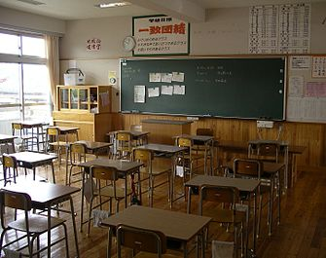

Slide 16
2)Lavatory :
The urinals and latrines should be adequate for the students.
It should be separate for boys and girls.
Adequate water supply should be provided.
3)Regular medical examination :
Medical, physical and psychological examination of all students and teachers must be done at least once a year.
For example: Examination for nutritional deficiency, special care to vision, hearing, and speech and teething.

Slide 17
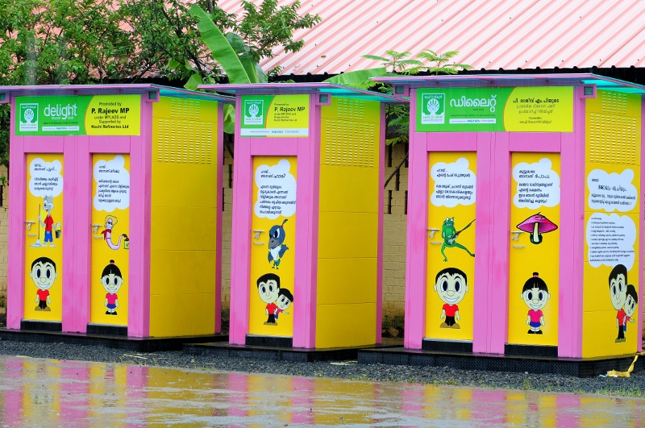
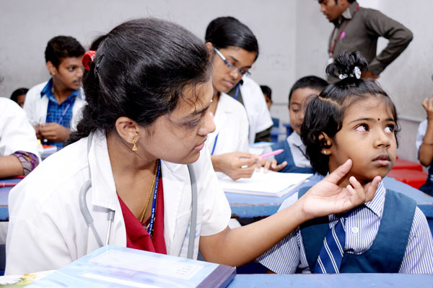

Slide 18
Cont---
First Aid
Eye check up
Healthful school environment
Dental health
Mental health
Immunization

Slide 19
FUNCTIONS OF SCHOOL HEALTH NURSE.
1)Assessment :
Assessment is a systemic collection of information concerning the health needs of school children.
It also includes the description of students and their health statistics, description of community, and an analysis of service available in the society.

Slide 20
2) Community assessment :
The students community consists of,
Family
Housing
Socio-economic status
Juvenile delinquency rate
Drug and alcohol usage
Divorce rate
Employment statistics
These information may be obtained by questionnaire, interviews, survey method, observation, discussion during PTA meetings.

Slide 21
3) Programme planning:
In planning the school health programme,
Determine the nursing health needs.
Establish the priority of need.
Identify strengths.
Form pattern of delivery service.
4)Screening tests:
Screening test includes procedure for
Testing vision and hearing.
Assessing growth and development.
Observations for scoliosis, dental and cardiac findings.
The screening test are selected according to their costs, availability, effectiveness and acceptability.

Slide 22
Vision
Usually annual examination help, detect signs for eye problem.
e.g. Reading difficulty, eye irritation, excessive rubbing.
Eye problem of the students may also affect their studies.
Hearing
Educating parents and children about potential for hearing loss resulting from infection is important.

Slide 23
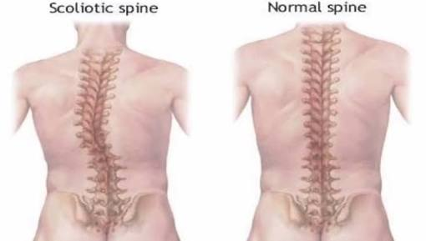
Scoliosis screening :
Early detection, treatment and physiotherapy may prevent costly major surgery.

Slide 24
SCHOOL HEALTH SERVICES
The school health services can be divided as :
1) School health education :
It is the process of providing learning experiences that favorably influences understanding, attitude and conduct relating to individual and community health which includes school health, safety instructions, general hygiene and prevention of accidents.

Slide 25
2) Healthful School Living:
It includes physical and social environment of the school and it's effect on student health.
SHP can take steps to provide appropriate environment for students.
Can also do assessment and observations.
3) Health supervision:
It includes activities such as health assessment, vision, hearing, emergency care, screening and identification of health deficit.

Slide 26
4) Health counseling :
Guidance and counseling regarding health behavior and recommendations to individual and group health conditions.
School health services involve health education to children can be given on,
Personal hygiene.
Dental hygiene.
Prevention of accidents.
Prevention of worm infection.
Balanced diet.

Slide 27
ADMINISTRATION OF SCHOOL HEALTH SERVICES
Primary Health Centre at rural areas are covering all the schools.
Medical officer and school health nurse visit every week to give regular care children.
School health administration at urban school are covered by school health clinics run by school health administration under local government

Slide 28
Cont---
3) The school provide medical check up, vaccination , medication, health education, and referral services.
After medical check up children should be treated appropriately and follow up is done.

Slide 29
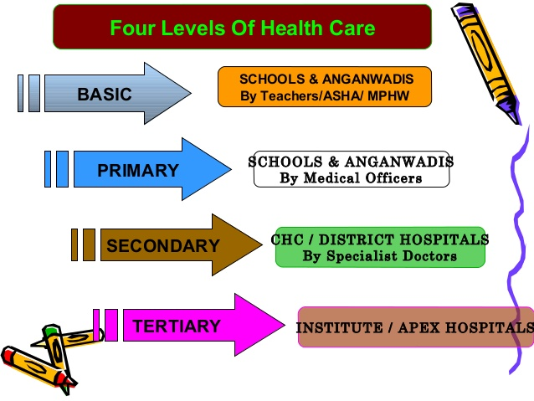

Slide 30
Role and responsibility of S.H.N
General physical examination
Identify any abnormalities
First aid services
Periodic visit
Immunization record
Safety school environment
Health records of each student

Slide 31
Bibliography
1) Gulani.K.K.Community health nursing. Principles and practices. 4th edition. Lunar publishing house. Ltd. New Delhi. 2005 page no. 435-437.
2) I.Clement.Basic concepts of community health nursing. 2nd edition.Jaypee brothers (p) Ltd. New Delhi. Page no. 277-288.
3) Patney Sunita . Textbook of community health nursing. 2nd edition. CBS publishers and distribution. New Delhi. 58-64
4) K.Park. Preventive and social Medicine, 20th edition M/S Banarasidas Bhanot. Jabalpur page no:498-509.
5) S. Kamalam. Essentials in CHN practice 3rd edition.Health science publishers ,New Delhi page no. 371
6) https://www.slideshare.net/mobile/kalyan-singh

Slide 32


